Slide 1
Predictive Model For British Airways
Important Features determining completed booking

Slide 2
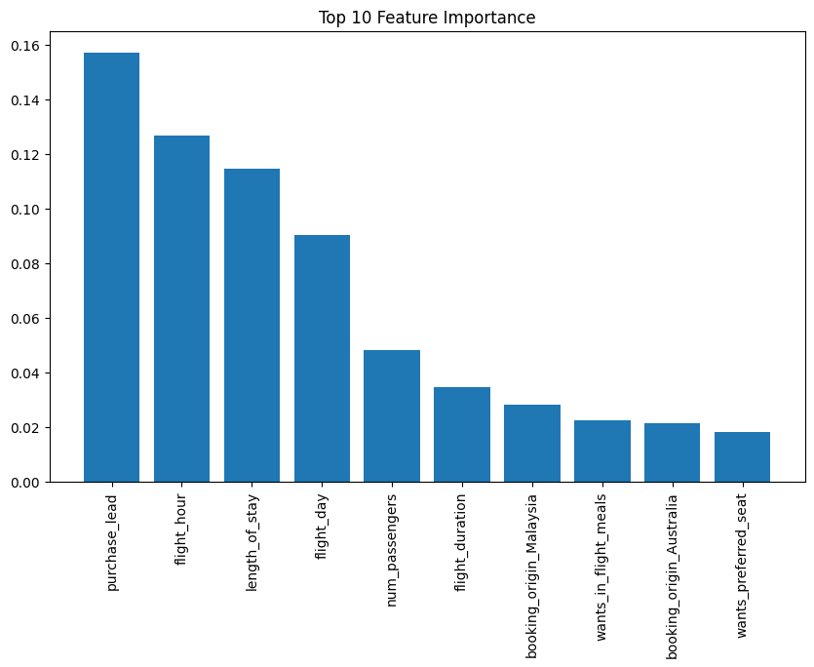
Features Overview
Key Features:
Purchase Lead (15.73%), Flight Hour (12.67%), Length of Stay (11.46%): Highest importance features.
Booking Origin Insight:
Malaysia (2.83%) and Australia (2.11%): Crucial factors in predictions.
Distribution: Australia (17,872 instances), Malaysia (7,174 instances).
Additional Insights:
Flight Day, Num Passengers, Flight Duration: Other impactful features.
In-Flight Meals and Preferred Seat Preferences: Also influential.
Recommendations:
Investigate reasons behind Malaysia and Australia's pivotal role.
Consider targeted strategies based on findings.

